Slide 1

Decision Making & Selection
Dr. Emily Tarr

Slide 2
Human Capital Flow
What work needs done?
Designing motivating jobs
Acquiring the right human capital
Ensuring that human capital is equipped to do their jobs well
Assessing role performance
Providing reinforcement

Slide 3

When hiring, what should you look for?

Slide 4
Three Candidates
 | Michael | Priya | Carlos
Gender | male | female | male
Age | Early 30s | Late 20s | Late 20s
Race/Ethnicity | Asian American | South Asian | Hispanic
Education | B.S. Computer Science | Master’s in Computer Engineering | B.S. Electrical Engineering
Experience | 5 years as a full-stack developer | 3 years as a backend developer | 4 years as a mobile app developer
Skills | Java, JavaScript, React, Node.js | Python, Django, SQL | Swift, Kotlin, iOS, Android
Career Highlights | Led a team that delivered a critical feature ahead of schedule | Optimized database queries, reducing response time by 30% | Developed an award-winning app with 100,000+ downloads
References | Strong endorsements from previous managers | Positive feedback from colleagues | Strong recommendations from professors
Salary Expectations | $100,000/year | $90,000/year | $80,000/year
Availability | Ready to start immediately | One month notice period | Flexible start date

Slide 5
How Should We Make Decisions?: The Rational Choice Paradigm
Rational Choice Paradigm: people should use logic and all available information to choose the alternative with the highest value
Rational = making consistent, value-maximizing choices within specified constraints
Choose the alternative with the highest subjective expected utility
The probability (expectation) of satisfaction (utility) resulting from choosing a specific alternative
When applicable, can calculate expected values
Expected value = value of the outcome x probability of the outcome
Example: Expected value of winning a dollar in a coin toss is 50 cents: 0.5 x $1.00 = $0.50

Slide 6

Managerial Decision Making
Management decisions are almost never straightforward and simple

Slide 7
Problems with the Rational Choice Paradigm
This model assumes people are efficient and logical information-processing machines
Bounded rationality: the view that people are bounded in their decision-making capabilities by a variety of constraints
This model does not take emotions into effect
Emotions also influence the decision-making process, and can both support and interfere with good decision-making

Slide 8
Information Processing: RCP Assumptions vs. Reality
Assumption: people will maximize in their decision making—they will choose the alternative with the highest subjective expected utility
Reality: People will often satisfice
Assumption: decision makers can process information about all alternatives and their consequences
Reality: people evaluate only a few alternatives and a few of the main outcomes of those alternatives
Assumption: decision makers evaluate alternatives simultaneously
Reality: we evaluate alternatives sequentially, and as a new alternative comes along, we immediately compare it to the implicit favorite

Slide 9

Time for a Quiz!

Slide 10
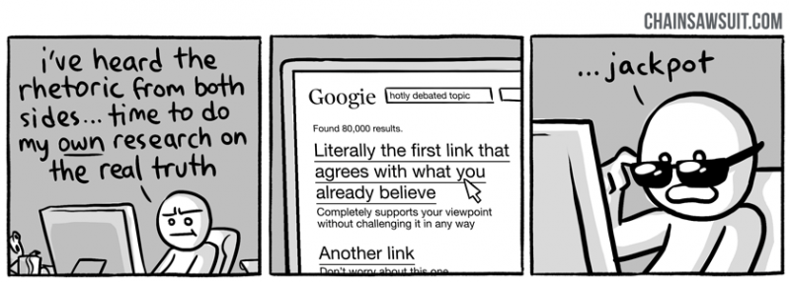
Confirmation Bias
The tendency to screen out information that is contradictory to decisions, beliefs, values, and assumptions, and readily accept information that confirms these things

Slide 11
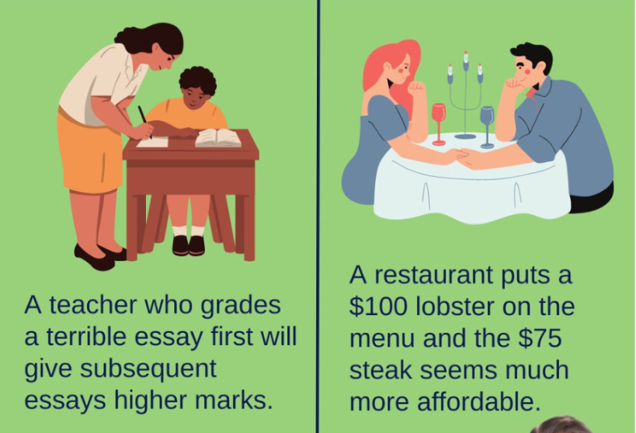
Contrast Effect
Making a comparison based upon what happened just before we make a decision or judgment

Slide 12
Self-Fulfilling Prophecy
The tendency for someone’s expectations about another to cause that individual to behave in a manner consistent with those expectations
Supervisor forms expectations
Employee’s behavior matches expectations
Expectations affect supervisor’s behaviors
Supervisor’s behavior affects employee

Slide 13

Primacy Effect
The tendency to quickly form an opinion of people on the basis of the first information we receive about them

Slide 14
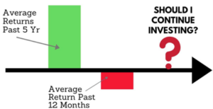
Recency Effect
The tendency for most recent items or experiences to be remembered best

Slide 15

Recruiting
Where should we recruit from?

Slide 16
Recruiting
Personnel policies
Recruiter traits and behaviors
Recruitment sources
Job choice
Vacancy characteristics
Applicant characteristics

Slide 17
Recruitment Sources
Internal
External
Direct applicants
Referrals
Job search/Networking platforms
Employment agencies
Colleges/universities

Slide 18
Selection Process
Personnel selection: the process through which organizations make decisions about who will or will not be invited to join the organization
Screening Applications and Resumes
Testing and Reviewing Work Samples
Interviewing Candidates
Checking References and Background
Making a Selection

Slide 19
Characteristics of Effective Selection Tools
The method provides reliable information
The method provides valid information
The information can be generalized to apply to the candidates
The method offers high utility
The selection criteria are legal

Slide 20
Reliability and Validity
Reliable: Is it measuring what it says it measures?
Valid: Will it relate highly to what it is designed to predict/assess?
Reliable, Not Valid
Neither Reliable nor Valid
Both Reliable and Valid

Slide 21
Non-Permissible Questions in Selection Process
What was your maiden name? (can ask if they’ve ever worked under a different name)
What’s the nationality of your name?
How old are you? How would you feel about working for someone younger than you?
What is your height? Your weight?
Do you have any disabilities? Have you ever been seriously ill?
Providing a picture
What is your ancestry? Where were you born?
Are you a citizen?
Is that school you attended affiliated with [religious group]?
When did you attend high school?
What is your religion? What religious holidays do you observe?
What is your marital status? Would you like to be addressed by Mrs./Ms./Miss?
Do you have any children?
Have you ever been arrested?
What organizations or groups do you belong to?

Slide 22
Job Applications
Application forms
Resumes
References
Background checks
Contact information, work experience, educational background, applicant's signature
An inexpensive way to collect information; provide employers with a starting point; may be biased in favor of the applicant
May be contact information or letters; also tend to be biased toward the applicant
A way to verify that applicants are as they represent themselves to be

Slide 23
Employment Tests and Work Samples
Aptitude tests: tests that assess how well a person can learn or acquire skills and abilities
Achievement tests: tests that measure a person’s existing knowledge and skills
Physical ability tests
Cognitive ability tests
Job performance tests and work samples
Personality inventories

Slide 24
Interviews: Advantages and Disadvantages
Advantages
Provides evidence of soft skills
A means to check the accuracy of information on resume
Disadvantages
Can be unreliable, low in validity, and biased
Costly
Subjective

Slide 25
Interviewing Techniques
Nondirective interview:
Structured interview:
Situational interview:
Behavior description interview (BDI):
The interviewer has great discretion in choosing questions to ask each candidate
Consists of a predetermined set of questions for the interviewer to ask
A structured interview in which the interviewer describes a situation likely to arise on the job, then asks the candidate what s/he would do in that situation
A structured interview in which the interviewer asks the candidate to describe how s/he handled a type of situation in the past

Slide 26
Interviews: Best Practices
Keep the interviews narrow, structured, and standardized
01
Focus on accomplishing specific goals
02
Train Interviewers
03
Use more than one person to conduct interviews
04

Slide 27
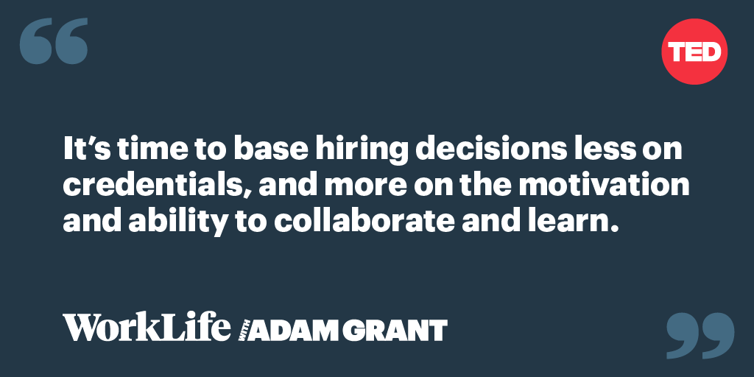
“Reinventing the Job Interview”

Slide 28
Small Group Discussion
What are some issues with traditional interviews? Have you noticed any other issues that go beyond what was mentioned in the podcast?
Consider the alternatives mentioned in the podcast (e.g., work samples, trial projects, job auditions, etc.). Pick one of these and discuss: (1) What it does better than a traditional interview; (2) What are the implementation challenges; (3) How inclusive is it for candidates from diverse backgrounds?
Redesign Challenge: Design a selection process that best mitigates the issues identified

